Slide 1

Ajax
Aris Markogiannakis
City University - Short Courses
CS3606 : JavaScript 2: Advanced Javascript for Websites and Web

Slide 2
This week?
This week we will learn about:
XMLHttpRequest
Fetch
Notes:
https://medium.freecodecamp.org/javascript-from-callbacks-to-async-await-1cc090ddad99

Slide 3
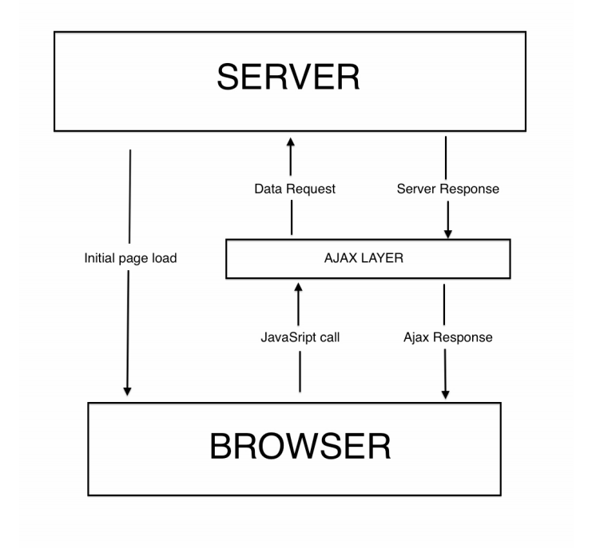
Ajax
Ajax lets you send HTTP requests to a web server from within your script
The server can send data back to you, which you can then use/display
This all happens without the page being reloaded

Slide 4
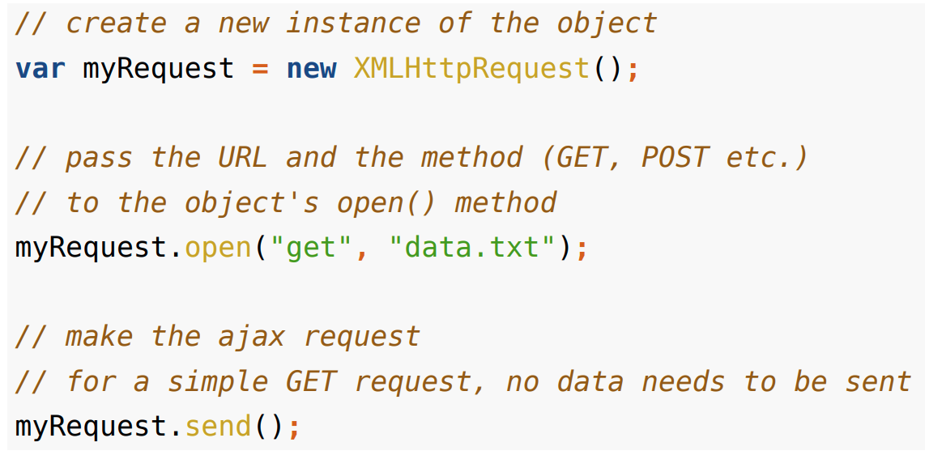
XMLHttpRequest
Ajax utilises the browser’s built-in XMLHttpRequest object.
It can retrieve data via the http, ftp or file protocols
The data can come in many different formats (xml, html, json, plain text etc.).

Slide 5
Requests are Asynchronous
When we call the send() method, the request is carried out asynchronously.
i.e. the request is added to the browser’s queue, to be executed when the browser is ready
Commonly, we expect the page we request to return some data to us
If we don’t know when the request will be executed, how do we access the data it returns?
We need a way of knowing when the request has completed…
At various stages of the request, a readystatechange event is fired by the browser
We can attach an event listener to this event, to monitor the request ▶ has it completed, is it still in progress, etc.
We use the XMLHttpRequest object’s onreadystatechange property to assign a listener for these events

Slide 6
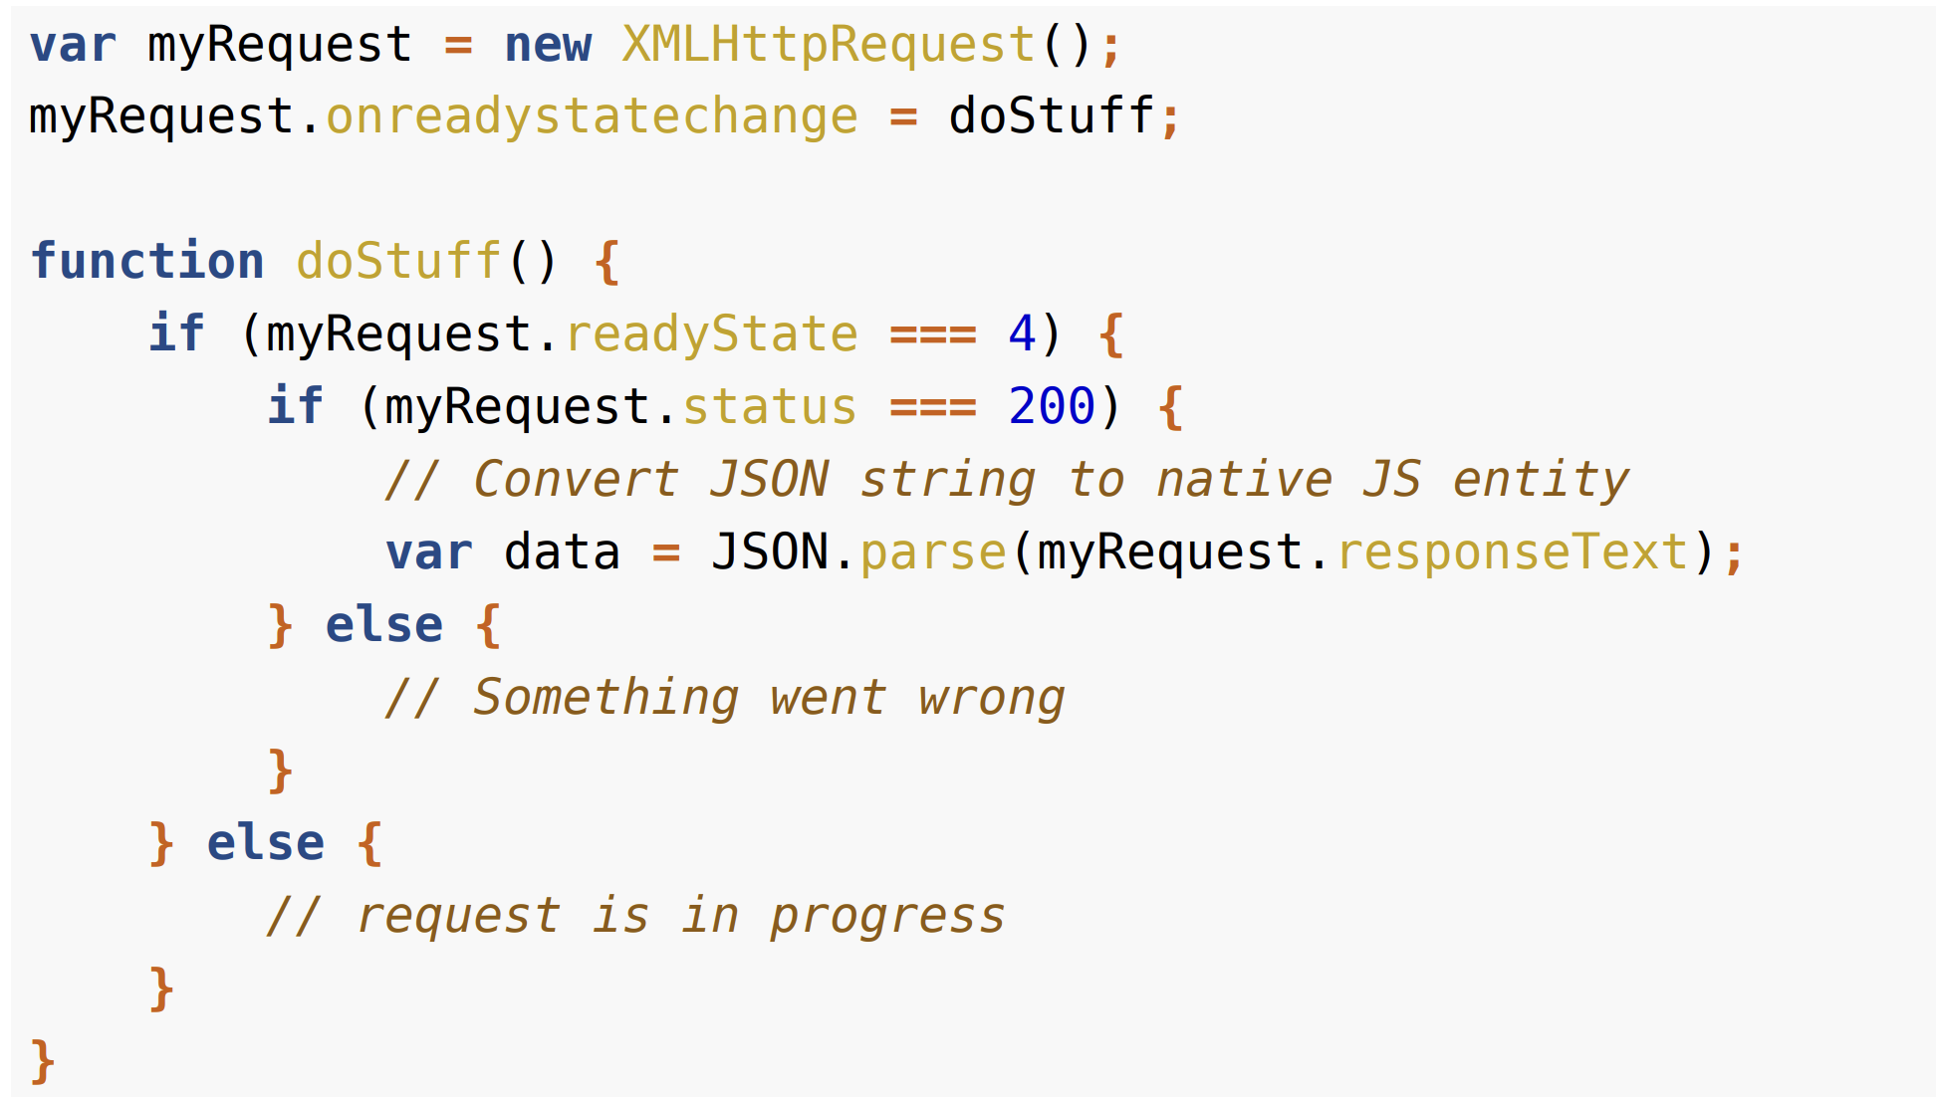
XMLHttpRequest
Historically, browser’s did their own thing when it came to implementing AJAX (some didn’t even call it XMLHttpRequest!)
As a result, we had to write several versions of our AJAX code (one for each browser!)
While modern browsers behave themselves (mostly), if you need to support the oldies, it is not easy, e.g IE9, IE8

Slide 7
Security Concerns
For security reasons, browsers implement a same-origin policy:
we can only make certain types of AJAX requests to URLs on the same domain as our script
There are different approaches to this problem:
CORS - a protocol that uses special HTTP headers when requests are sent/received - IDEAL to use if the server responds with CORS
iframes - the old-school solution, rarely used today
JSONP - An alternative way of sending JSON data over the wire (uses script tags and callback functions) - if the server doesn't respond with CORS we this

Slide 8
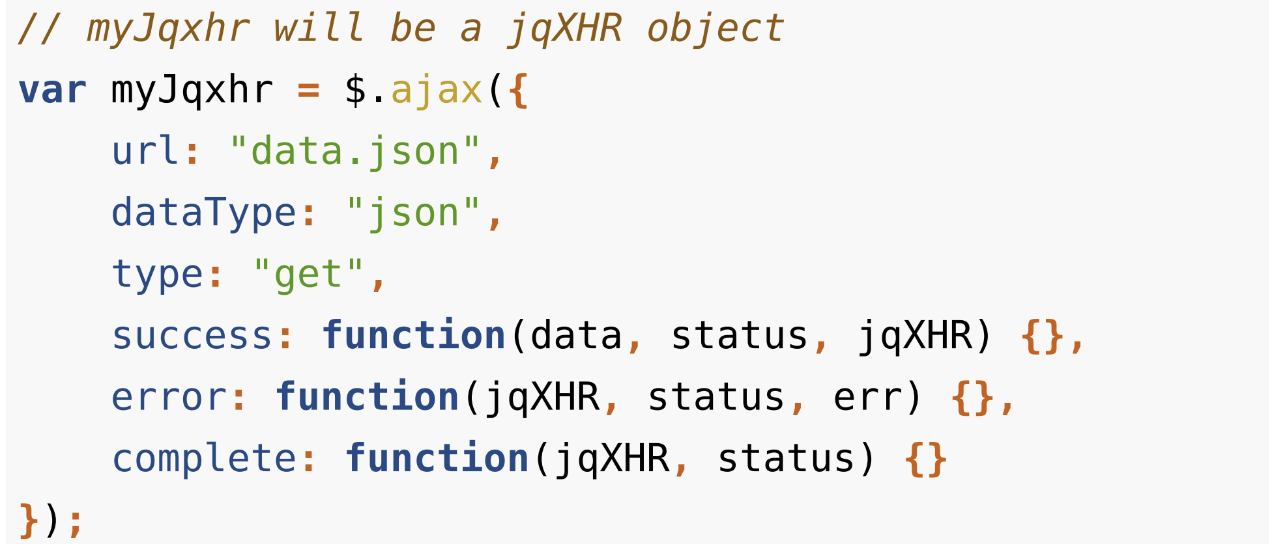
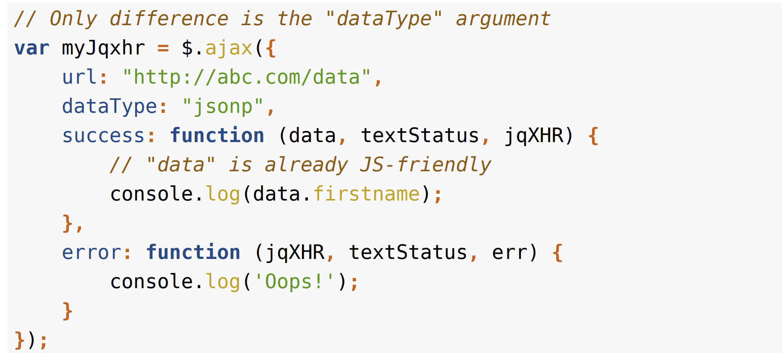
An example
url : The URL to send request to
dataType: The type of data type the server will return (JSON, HTML, etc.).
type: The method to use (get, post, etc.)
success, error, complete: callback functions to run when request finishes

Slide 9

JSON
JSON is a data storage format, which uses the JavaScript object notation syntax.
It is:
Lightweight
transferable as text (frequently used with AJAX)
easy to use with JavaScript as it uses similar syntax.
An example
{
"firstname": "John",
"lastname": "Smith",
"age": 25
}
Notes:
https://developer.twitter.com/en/docs/tweets/data-dictionary/overview/tweet-object

Slide 10
JSON Rules
All the property names of a JSON object need to be enclosed in double quotes.
JSON objects are enclosed in { } (just like JS)
JSON arrays are enclosed in [ ] (just like JS) Everything in a JSON data structure must be stored in an object or an array.
The official JSON language specification: http://www.json.org/
Use this website to validate a json file https://jsonlint.com/

Slide 11
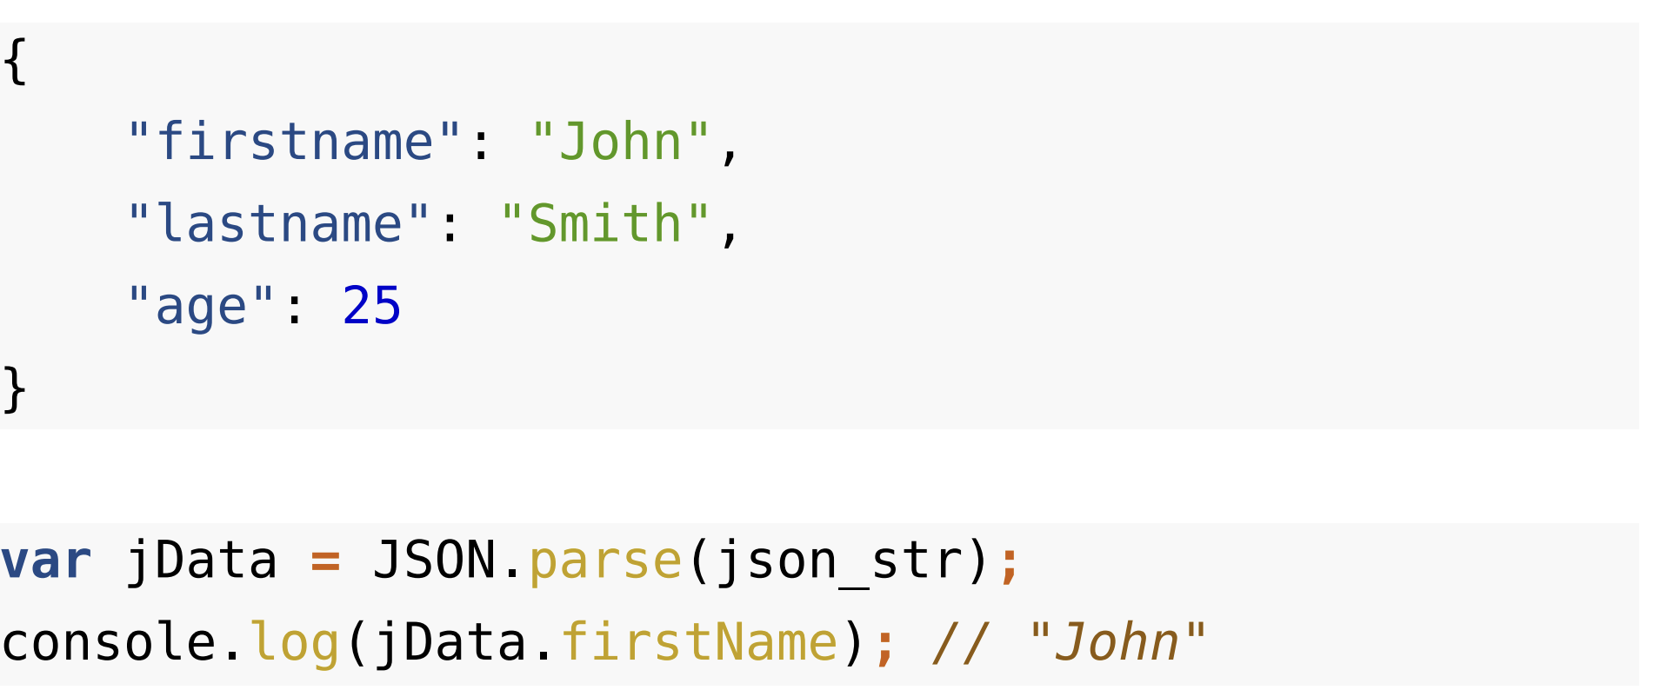
JSON and JavaScript
We can parse a JSON using JSON.parse()

Slide 12
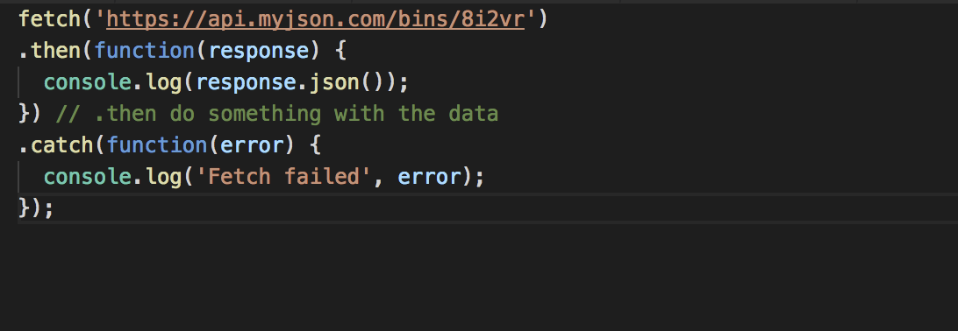
window.fetch
Modern replacement for XMLHttpRequest
Handles redirection, decodes common formats
Promise based (cleaner code)
Used by service workers, cache API, etc
Implements CORS

Slide 13
Exercise 1
Open the exercise that I will send you from Slack.
Notes:
https://google-developer-training.gitbooks.io/progressive-web-apps-ilt-codelabs/content/docs/lab_fetch_api.html

